Slide 1
Problem statement
Transform the following formula into prenex, Skolem and clausal normal forms.

Slide 2
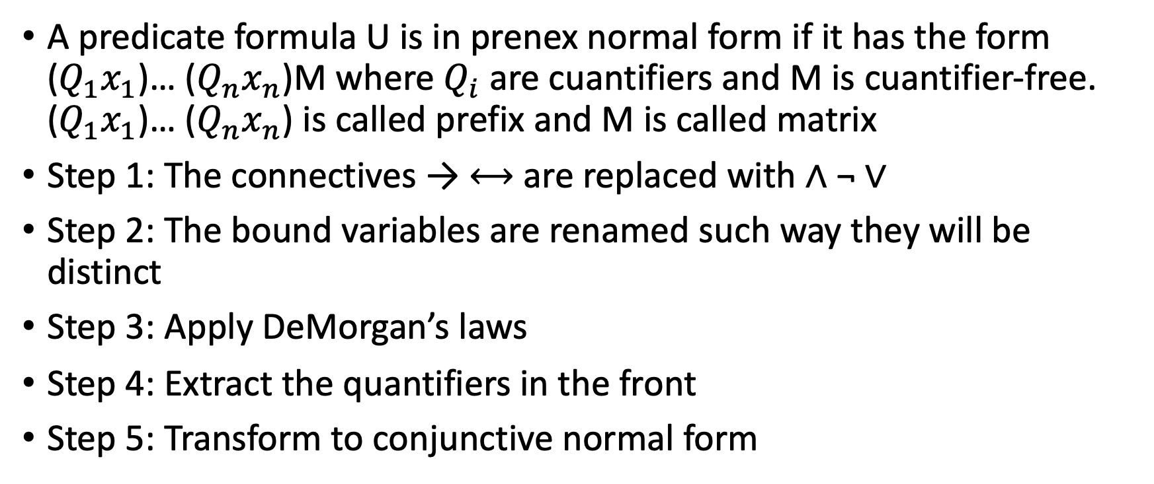
Theory
A predicate formula U is in prenex normal form if it has the form ($Q_{1}x_{1}$)… ($Q_{n}x_{n}$)M where $Q_{i}$ are cuantifiers and M is cuantifier-free. ($Q_{1}x_{1}$)… ($Q_{n}x_{n}$) is called prefix and M is called matrix
Step 1: The connectives → ⟷ are replaced with ∧ ¬ ∨
Step 2: The bound variables are renamed such way they will be distinct
Step 3: Apply DeMorgan’s laws
Step 4: Extract the quantifiers in the front
Step 5: Transform to conjunctive normal form

Slide 3
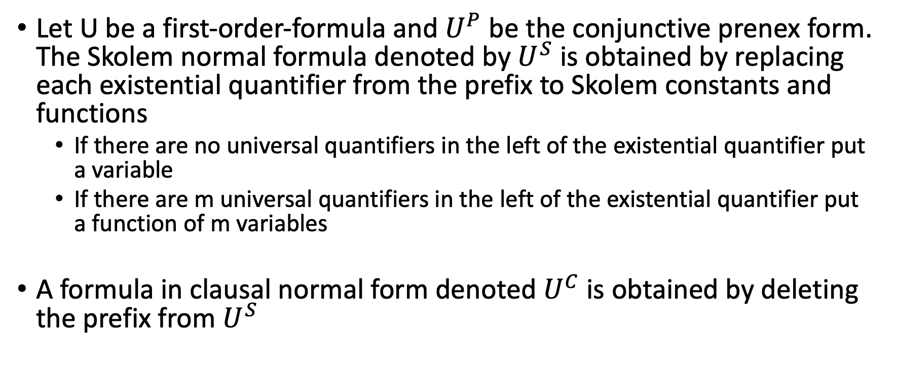
Theory (Contd)
Let U be a first-order-formula and $U^{P}$ be the conjunctive prenex form. The Skolem normal formula denoted by $U^{S}$ is obtained by replacing each existential quantifier from the prefix to Skolem constants and functions
If there are no universal quantifiers in the left of the existential quantifier put a variable
If there are m universal quantifiers in the left of the existential quantifier put a function of m variables
A formula in clausal normal form denoted $U^{C}$ is obtained by deleting the prefix from $U^{S}$

Slide 4
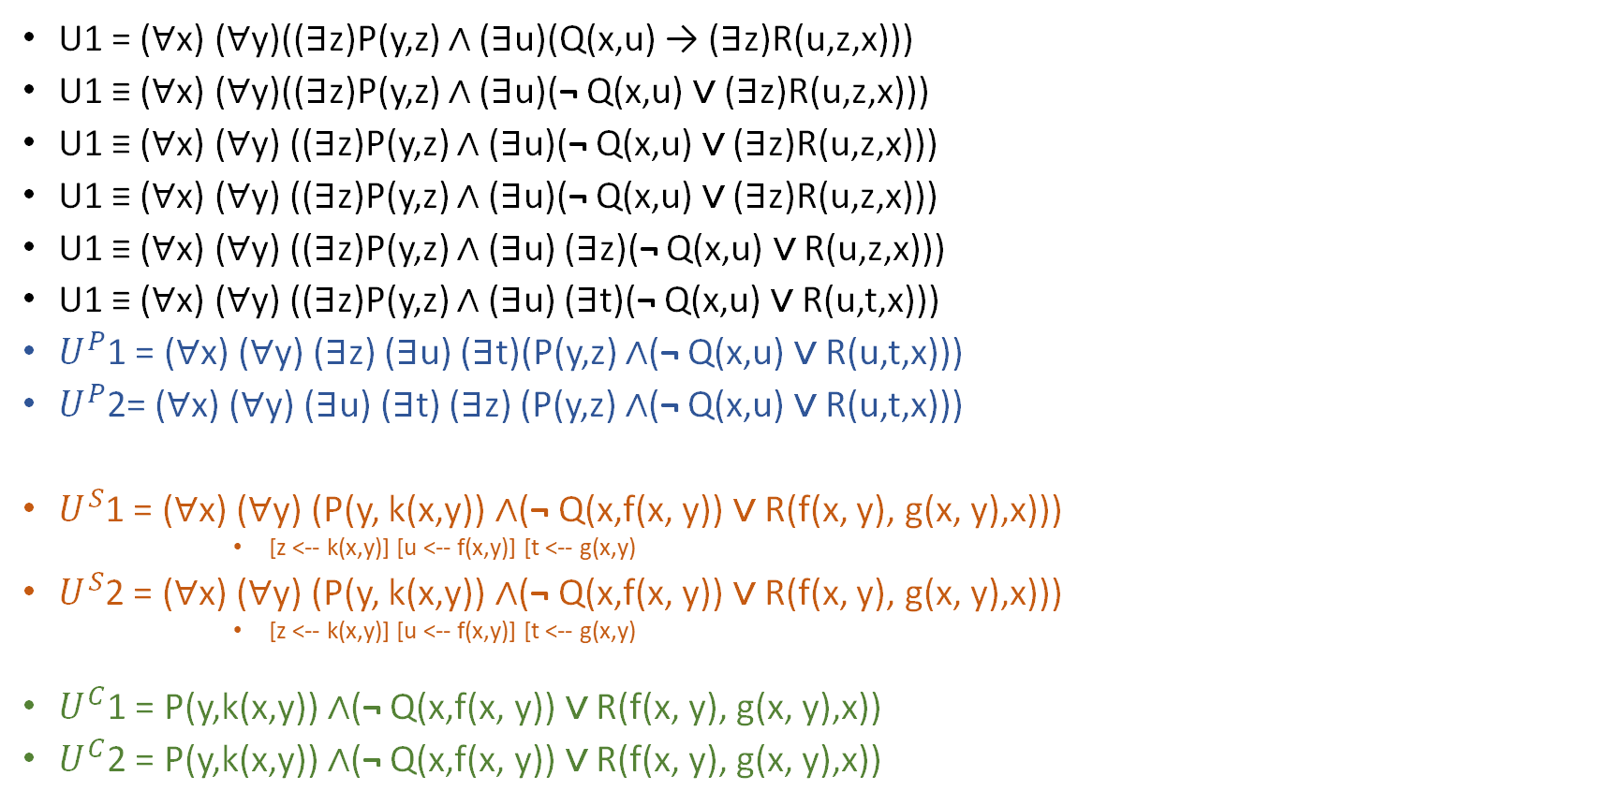
Solution
U1 = (∀x) (∀y)((∃z)P(y,z) ∧ (∃u)(Q(x,u) → (∃z)R(u,z,x)))
U1 ≡ (∀x) (∀y)((∃z)P(y,z) ∧ (∃u)(¬ Q(x,u) ∨ (∃z)R(u,z,x)))
U1 ≡ (∀x) (∀y) ((∃z)P(y,z) ∧ (∃u)(¬ Q(x,u) ∨ (∃z)R(u,z,x)))
U1 ≡ (∀x) (∀y) ((∃z)P(y,z) ∧ (∃u)(¬ Q(x,u) ∨ (∃z)R(u,z,x)))
U1 ≡ (∀x) (∀y) ((∃z)P(y,z) ∧ (∃u) (∃z)(¬ Q(x,u) ∨ R(u,z,x)))
U1 ≡ (∀x) (∀y) ((∃z)P(y,z) ∧ (∃u) (∃t)(¬ Q(x,u) ∨ R(u,t,x)))
$U^{P}$1 = (∀x) (∀y) (∃z) (∃u) (∃t)(P(y,z) ∧(¬ Q(x,u) ∨ R(u,t,x)))
$U^{P}$2= (∀x) (∀y) (∃u) (∃t) (∃z) (P(y,z) ∧(¬ Q(x,u) ∨ R(u,t,x)))
$U^{S}$1 = (∀x) (∀y) (P(y, k(x,y)) ∧(¬ Q(x,f(x, y)) ∨ R(f(x, y), g(x, y),x)))
[z <-- k(x,y)] [u <-- f(x,y)] [t <-- g(x,y)
$U^{S}$2 = (∀x) (∀y) (P(y, k(x,y)) ∧(¬ Q(x,f(x, y)) ∨ R(f(x, y), g(x, y),x)))
[z <-- k(x,y)] [u <-- f(x,y)] [t <-- g(x,y)
$U^{C}$1 = P(y,k(x,y)) ∧(¬ Q(x,f(x, y)) ∨ R(f(x, y), g(x, y),x))
$U^{C}$2 = P(y,k(x,y)) ∧(¬ Q(x,f(x, y)) ∨ R(f(x, y), g(x, y),x))

Slide 5
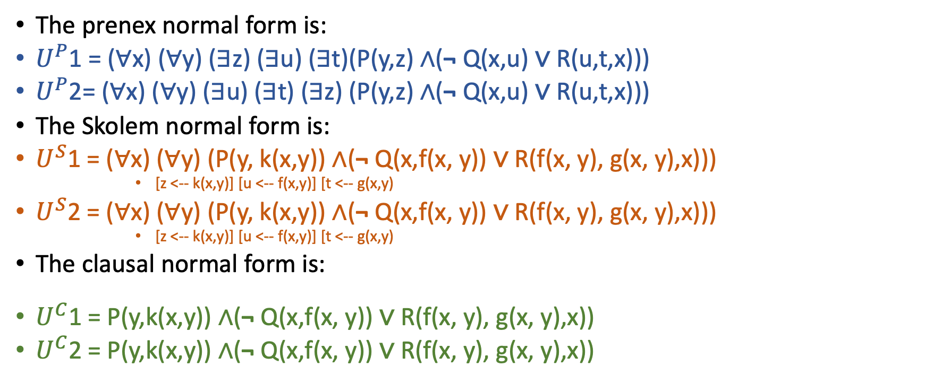
Conclusions
The prenex normal form is:
$U^{P}$1 = (∀x) (∀y) (∃z) (∃u) (∃t)(P(y,z) ∧(¬ Q(x,u) ∨ R(u,t,x)))
$U^{P}$2= (∀x) (∀y) (∃u) (∃t) (∃z) (P(y,z) ∧(¬ Q(x,u) ∨ R(u,t,x)))
The Skolem normal form is:
$U^{S}$1 = (∀x) (∀y) (P(y, k(x,y)) ∧(¬ Q(x,f(x, y)) ∨ R(f(x, y), g(x, y),x)))
[z <-- k(x,y)] [u <-- f(x,y)] [t <-- g(x,y)
$U^{S}$2 = (∀x) (∀y) (P(y, k(x,y)) ∧(¬ Q(x,f(x, y)) ∨ R(f(x, y), g(x, y),x)))
[z <-- k(x,y)] [u <-- f(x,y)] [t <-- g(x,y)
The clausal normal form is:
$U^{C}$1 = P(y,k(x,y)) ∧(¬ Q(x,f(x, y)) ∨ R(f(x, y), g(x, y),x))
$U^{C}$2 = P(y,k(x,y)) ∧(¬ Q(x,f(x, y)) ∨ R(f(x, y), g(x, y),x))

